Slide 1

Learn SQL From Scratch
Capstone Project - First- and Last-Touch Attribution with CoolTShirts.com
Archana Ram | August 19 2018

Slide 2
Table of Contents
About CoolTShirts (CTS) & Project Goal
Getting familiar with the company
What is their user journey?
Optimizing their campaign budget

Slide 3
1. About CoolTShirts & Goals

Slide 4
1.1 CoolTShirts and Project Goal
CoolTShirts is an innovative apparel shop. The company is running a bunch of marketing campaigns to increase user attribution and purchases.
Goal of this project is make campaign recommendations by analyzing the user attribution journey through the various campaigns that CTS is actively running.

Slide 5
2. Getting Familiar

Slide 6
2.1 # of Campaigns and # of Sources
How many campaigns does CoolTShirts use?
CTS uses 8 campaigns to reach out to their customers.
How many sources does CoolTShirts use?
CTS uses 6 sources to interact with their customers.
SELECT COUNT(DISTINCT utm_campaign)
AS 'Total Campaigns’
FROM page_visits;
SELECT COUNT(DISTINCT utm_source)
AS 'Total Sources'
FROM page_visits;
Total Campaigns
8
Total Sources
6

Slide 7
2.2 Campaign and Sources Relationship
How are campaigns and sources related? Explain the difference between utm_campaign and utm_source.
Marketing Campaign is an activity aimed at boosting product sales, company awareness and customer engagement. utm_campaign in page_visits stores the different types of campaigns that CTS uses.
Marketing source is the method used to engage with the customer during the campaigns. utm_source stores the various touchpoint that triggers the user action directing users to CTS website.
Each CTS campaign uses a specific source to engage with the customers. Its obvious from the results that email and google are popular sources each shared across 2 different campaigns.
UTM Campaigns | UTM Sources
getting-to-know-cool-tshirts | nytimes
weekly-newsletter | email
ten-crazy-cool-tshirts-facts | buzzfeed
retargetting-campaign | email
retargetting-ad | facebook
interview-with-cool-tshirts-founder | medium
paid-search | google
cool-tshirts-search | google
SELECT DISTINCT utm_campaign AS 'UTM Campaigns',
utm_source AS 'UTM Sources'
FROM page_visits;

Slide 8
2.3 Pages on CTS website
What pages are on their website?
CTS website has the following pages:
SELECT DISTINCT page_name
AS 'CTS webpages'
FROM page_visits;
CTS webpages
1 - landing_page
2 - shopping_cart
3 - checkout
4 - purchase

Slide 9
3. User Journey

Slide 10
3.1 First Touch Insights
How many first touches is each campaign responsible for?
The First Touch attribution refers to the first time consumers interact with CTS through a campaign/source.
Four campaigns are attributed for users’ first touch to CTS.
Minimum first touches that a campaign brought in is 169 and the maximum is 622.
WITH first_touch AS (
SELECT user_id,
MIN(timestamp) AS 'first_touch_at'
FROM page_visits
GROUP BY 1),
ft_attr AS(
SELECT ft.user_id,
ft.first_touch_at,
pv.utm_source,
pv.utm_campaign
FROM first_touch ft
JOIN page_visits pv
ON ft.user_id = pv.user_id
AND ft.first_touch_at = pv.timestamp
)
SELECT ft_attr.utm_campaign AS 'Campaign',
/* ft_attr.utm_source AS 'Source', */
COUNT(*) AS 'Total First Touches'
FROM ft_attr
GROUP BY 1
ORDER BY 2 ASC;
Campaign | Total First Touches
cool-tshirts-search | 169
ten-crazy-cool-tshirts-facts | 576
getting-to-know-cool-tshirts | 612
interview-with-cool-tshirts-founder | 622
* Commented out the source column from the output since the question is asking about campaigns.

Slide 11
3.2 Last Touch Insights
How many last touches is each campaign responsible for?
Last touch refers to the campaigns that drew users’ back to CTS.
The list below shows how many last touches each campaign is responsible for.
WITH last_touch AS (
SELECT user_id,
MAX(timestamp) AS 'last_touch_at'
FROM page_visits
GROUP BY 1),
lt_attr AS(
SELECT lt.user_id,
lt.last_touch_at,
pv.utm_source,
pv.utm_campaign
FROM last_touch lt
JOIN page_visits pv
ON lt.user_id = pv.user_id
AND lt.last_touch_at = pv.timestamp
)
SELECT lt_attr.utm_campaign AS 'Campaign',
/* lt_attr.utm_source AS 'Source', */
COUNT(*) AS 'Total Last Touches'
FROM lt_attr
GROUP BY 1
ORDER BY 2 ASC;
Campaign | Total Last Touches
cool-tshirts-search | 60
paid-search | 178
interview-with-cool-tshirts-founder | 184
ten-crazy-cool-tshirts-facts | 190
getting-to-know-cool-tshirts | 232
retargetting-campaign | 245
retargetting-ad | 443
weekly-newsletter | 447
* Commented out the source column from the output since the question is asking about campaigns.

Slide 12
3.3 Purchase Insights
How many visitors make a purchase?
A total of 361 visitors visited the purchase page of CTS.
SELECT page_name AS 'Page',
COUNT(DISTINCT user_id) AS 'Total Visitors'
FROM page_visits
GROUP BY 1
HAVING page_name LIKE '%purchase%';
Page | Total Visitors
4 - purchase | 361

Slide 13
3.4 Last Touch At Purchase Insights
How many last touches on the purchase page is each campaign responsible for?
The list below shows the campaigns responsible for last touch on purchase.
WITH last_touch_purchase AS (
SELECT user_id,
MAX(timestamp) AS 'last_touch_at'
FROM page_visits
WHERE page_name = '4 - purchase'
GROUP BY 1),
lt_attr AS(
SELECT lt.user_id,
lt.last_touch_at,
pv.utm_source,
pv.utm_campaign
FROM last_touch_purchase lt
JOIN page_visits pv
ON lt.user_id = pv.user_id
AND lt.last_touch_at = pv.timestamp
)
SELECT lt_attr.utm_campaign AS 'Campaign',
/* lt_attr.utm_source AS 'Source', */
COUNT(*) AS 'Last Touch At Purchase'
FROM lt_attr
GROUP BY 1
ORDER BY 2 ASC;
Campaign | Last Touch At Purchase
cool-tshirts-search | 2
interview-with-cool-tshirts-founder | 7
getting-to-know-cool-tshirts | 9
ten-crazy-cool-tshirts-facts | 9
paid-search | 52
retargetting-campaign | 54
retargetting-ad | 113
weekly-newsletter | 115
* Commented out the source column from the output since the question is asking about campaigns.

Slide 14
3.5 User Journey
What is the typical user journey?
Of the 2000 users who visit the CTS website, it can be seen that the funnel of users visiting the checkout page is still decent but the users converting their visits into a purchase drops down significantly to just 361.
interview-with-cool-tshirts-founder is a successful campaign that attracts a lot of first touch attribution.
weekly-newsletter and retargetting-ad are successful campaigns bringing in a lot of last touch attributions/users and these campaigns draw users back especially into the purchase page indicating purchases.
SELECT page_name AS 'Page’,
COUNT(*) AS 'Visits per page'
FROM page_visits
GROUP BY 1;
Page | Visits per page
1 - landing_page | 2000
2 - shopping_cart | 1900
3 - checkout | 1431
4 - purchase | 361

Slide 15
4. Campaign Recommendations

Slide 16
4.1 Campaign Recommendations
CoolTShirts can re-invest in 5 campaigns. Which should they pick and why?
Depending on the goal that CTS wishes to attain, here are a few recommendations, in this order, to re-invest in the 5 campaigns:
To increase company/product awareness among consumers and purchase volume - C1, C2, C5, C6, C7
To increase purchase only – C3, C4b, C5, C6, C7
To increase last touch attribution only – C3, C4a, C5, C6, C7
ID | Campaign | Total First Touches
C1 | getting-to-know-cool-tshirts | 612
C2 | interview-with-cool-tshirts-founder | 622
ID | Campaign | Total Last Touches | Last Touch At Purchase
C3 | ten-crazy-cool-tshirts-facts | 190 | 9
C4a | C4b | getting-to-know-cool-tshirts | paid-search | 232 | 178 | 9 | 52
C5 | retargetting-campaign | 245 | 54
C6 | retargetting-ad | 443 | 113
C7 | weekly-newsletter | 447 | 115
* C = Campaign

Slide 17
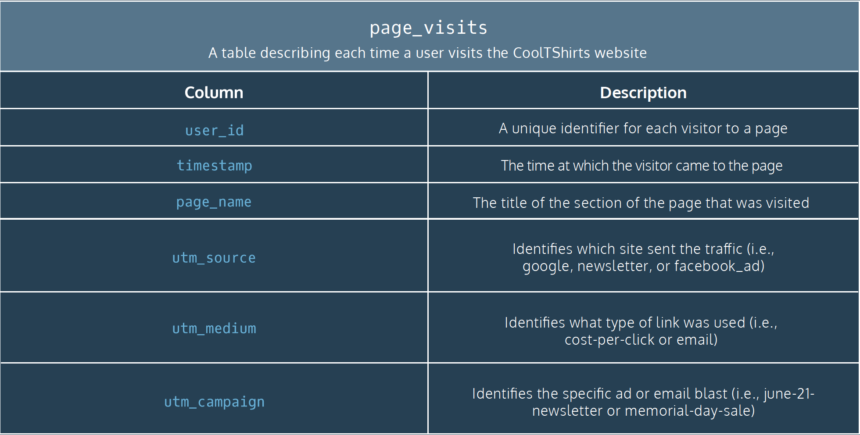
CTS Page Visits Table Schema
* For reference

Slide 18
<Thank You>
Capstone Project - First- and Last-Touch Attribution with CoolTShirts.com
Archana Ram | August 19 2018

